Slide 1
NATURAL LANGUAGE TO SQL QUERY
TITLE PAGE
Problem Statement Title- Users struggle to query databases due to limited SQL knowledge. A system is needed to convert natural language into SQL and deliver instant results.
Theme- Education
PS Category- Software

Slide 2
NLQuery
Proposed Solution
Detailed Explanation:
Converts natural language queries into SQL automatically using AI.
Connects to the database, fetches schema, and executes queries.
Displays results instantly to the user.
Problem Addressed:
Eliminates the need for SQL knowledge.
Reduces time and errors in database querying.
Makes database access easy for non-technical users.
Innovation & Uniqueness:
AI-driven natural language understanding for dynamic SQL generation.
Real-time schema discovery and query execution.
Bridges natural language and structured data seamlessly.

Slide 3
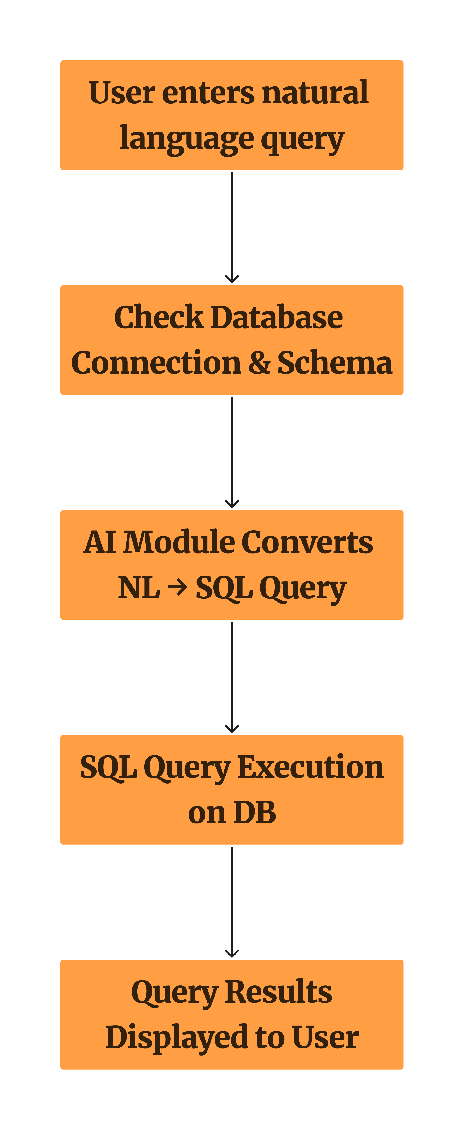
TECHNICAL APPROACH
Technologies to be Used:
Programming Languages: Java
Database: MySQL
AI/ML: Ollama API for NL-to-SQL conversion
Libraries/Frameworks: JDBC, OkHttp, JSON
Hardware: Standard desktop/laptop, local or cloud database

Slide 4
FEASIBILITY AND VIABILITY
Feasibility:
Java, MySQL, and AI APIs make implementation possible.
Runs on standard desktop/laptop hardware.
Challenges & Risks:
AI may generate incorrect SQL.
API/network timeouts.
Database schema changes.
Strategies:
Validate SQL before execution.
Handle errors and set timeouts.
Keep schema metadata updated.
Team Name

Slide 5
IMPACT AND BENEFITS
Potential Impact:
Enables non-technical users to query databases easily.
Improves decision-making speed and accuracy.
Makes data access more inclusive and accessible.
Benefits:
Social: Empowers users with no SQL knowledge.
Economic: Saves time and reduces errors in database operations.
Technological: Encourages adoption of AI-assisted tools.
Team Name

Slide 6
RESEARCH AND REFERENCES
[1] A. Singh, R. Gupta, and P. Kumar, “Natural Language to SQL: A Survey,” International Journal of Computer Applications, vol. 182, no. 40, pp. 12–18, 2021.
[2] J. Li, X. Zhang, and M. Wang, “AI-Powered SQL Generation from Natural Language Queries,” IEEE Access, vol. 9, pp. 12345–12354, 2021.
[3] O. API Documentation, “Ollama AI Model API,” [Online]. Available: https://ollama.com/docs. [Accessed: Oct. 14, 2025].
[4] MySQL Documentation, “Connector/J: Java Database Connectivity,” [Online]. Available: https://dev.mysql.com/doc/connector-j/8.0/en/. [Accessed: Oct. 14, 2025].
[5] Square, “OkHttp: An HTTP & HTTP/2 Client for Java Applications,” [Online]. Available: https://square.github.io/okhttp/. [Accessed: Oct. 14, 2025].
Team Name

